Slide 1



Data Professional Survey Breakdown: Dom Contestabile
View in Power BI
Last data refresh:
1/10/2024 12:59:12 AM UTC
Downloaded at:
1/10/2024 1:25:00 AM UTC

Slide 2
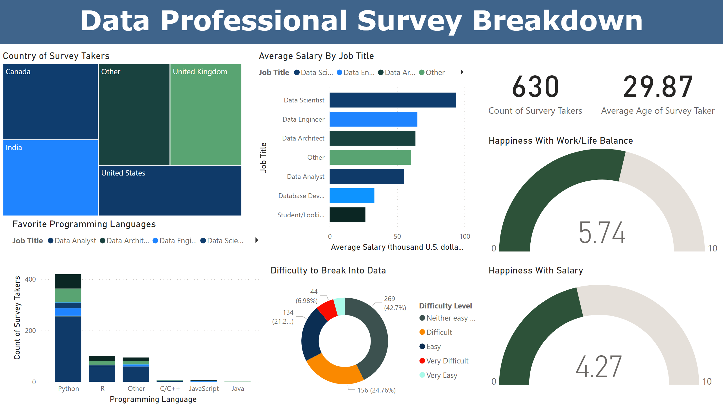
Page 1
Notes:
textbox
No alt text provided
card
No alt text provided
card
No alt text provided
Average Salary By Job Title
No alt text provided
Favorite Programming Languages
No alt text provided
Country of Survey Takers
No alt text provided
Happiness With Work/Life Balance
No alt text provided
Happiness With Salary
No alt text provided
Difficulty to Break Into Data
No alt text provided

